Slide 1
HARPURSVILLE CENTRAL SCHOOL DISTRICT
Budget Development for 2023-2024
Based on the Executive Proposal
March 8, 2023

Slide 2
Tonight’s Topics
Budget goals
Projected revenues
  Local revenue
  “Other” revenue
  State aid – based on Executive proposal
Expenditure discussions
Capital Outlay
Bus Vote
Next steps

Slide 3
Budget Goals
Be mindful of current and future needs
Provide an instructional program that meets the educational needs of all students
Promote the fiscal health and stability of the school district
Discuss federal stimulus funds and the impact on future budgets

Slide 4
PROJECTED REVENUES
Developed using:
Executive proposal of state aid
Tax levy limit calculation
Prior year trends/data for other revenues

Slide 5
PROJECTED REVENUES

Slide 6
PROJECTED REVENUES
Tax Levy

Slide 7
PROJECTED REVENUES - “Other” Revenue

Slide 8
PROJECTED REVENUES
“State Aid”

Slide 9
Projected Expenditures
Developed using:
Known benefit rate changes
Known contractual costs/estimated contractual increases
Known debt service payments
Projected BOCES expenditures

Slide 10
Projected Expenditures

Slide 11
Summary…

Slide 12

Capital Outlay Project
HS Wood Flooring – some classroom wood floors still need to be refinished (need to quantify how many rooms) (some DO flooring as well)
OES Room 318 Floor Correction – existing plank settled and a crack developed. Remove existing flooring, replace topping and installed new finish (approx $36k + escalation from 2019)
Potential Elevator updates
Update External Doors

Slide 13
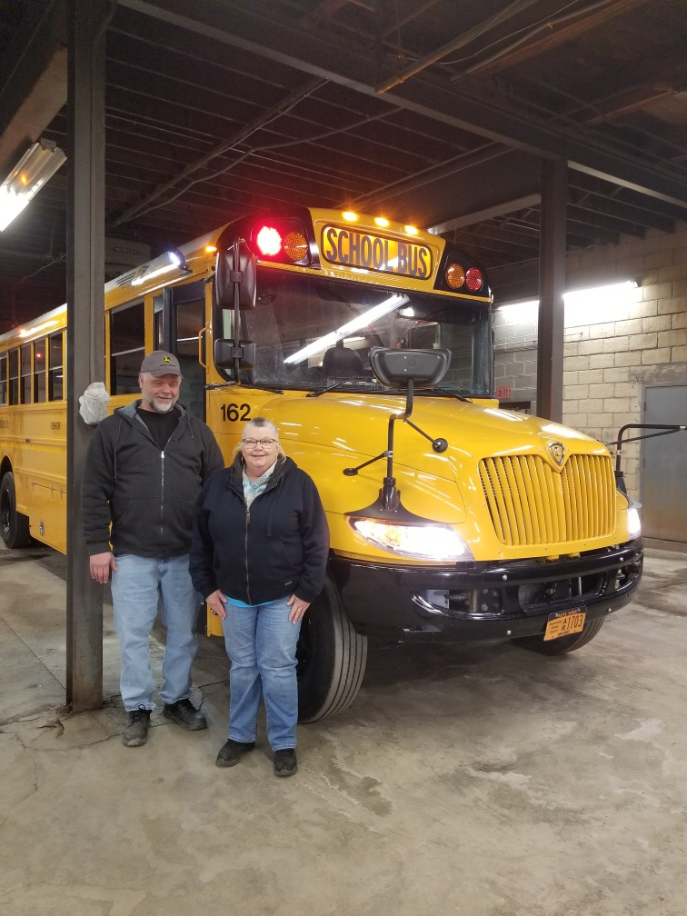
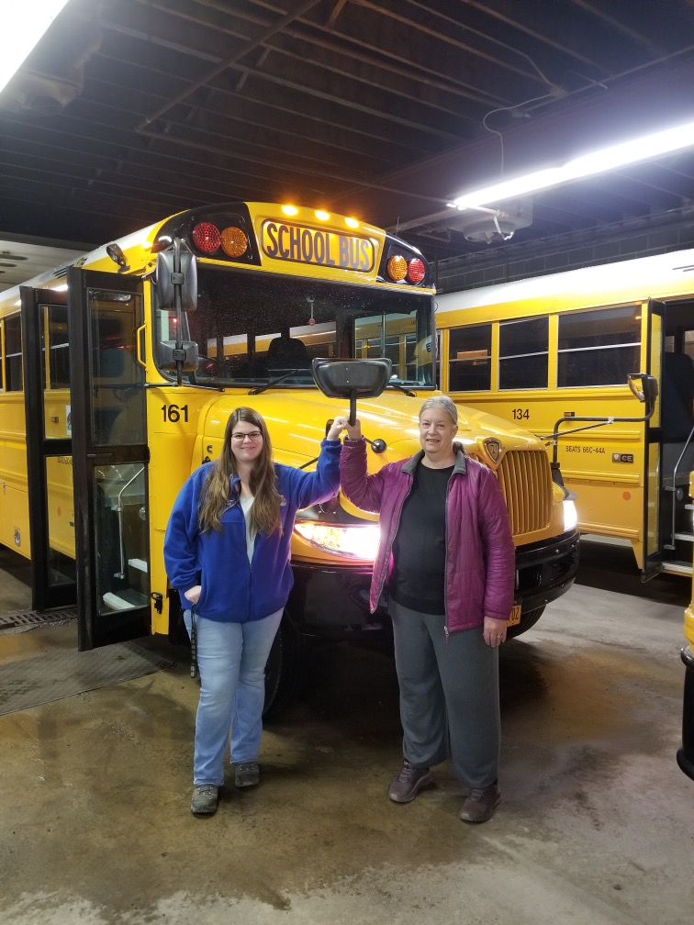

Bus Vote
Address current fleet size
  (17 large buses and 3 small) looking to continue to downsize the fleet
Cost and options for 2023 bus purchase
  (3) 66 Passenger Diesel Bus ($166,559.93 each)
    Total: 3 buses for $499,679.79
  Trades – likely 4 buses

Slide 14
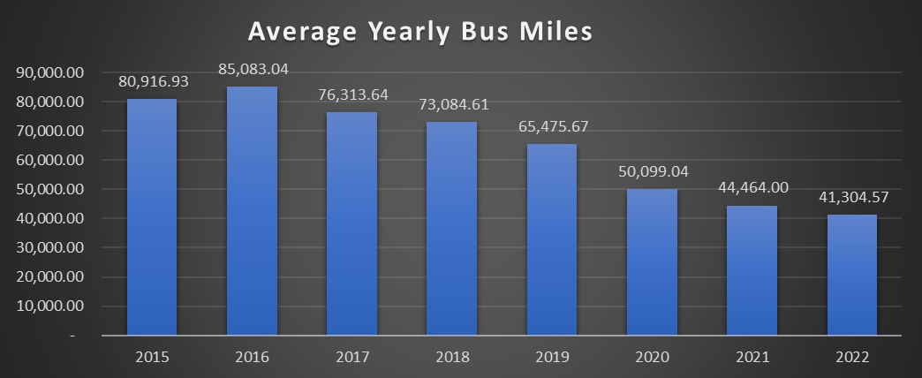
Average Yearly Mileage of Fleet

Slide 15
Next steps
Anticipate the Legislative proposal for school funding
Continue to review and refine the BOCES budget
April 17th – Present/Accept Final Budget
May 3rd – Budget Hearing
May 16th – Budget Vote

Slide 16

Thank You!

